Slide 1

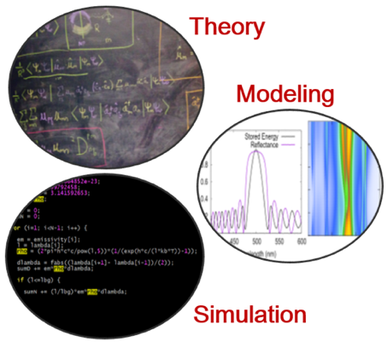
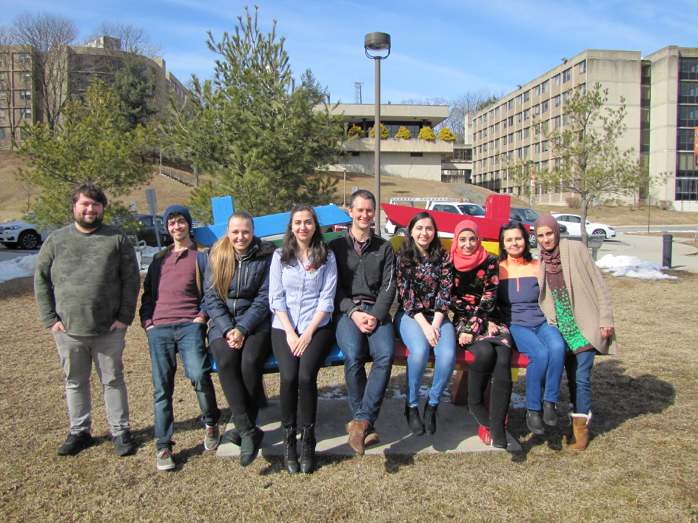
Jay Foley Assistant Professor Department of Chemistry William Paterson University
@Foley_Lab
https://foleylab.github.io
foleyj10@wpunj.edu
https://foleylab.github.io/wptherml/
Argonne National Laboratory
Postdoctoral Fellow 2012-2015
The University of Chicago
Ph.D. in Physical/Theoretical Chemistry 2007-2012
Georgia Institute of Technology
B.S. in Chemistry 2006

Slide 2
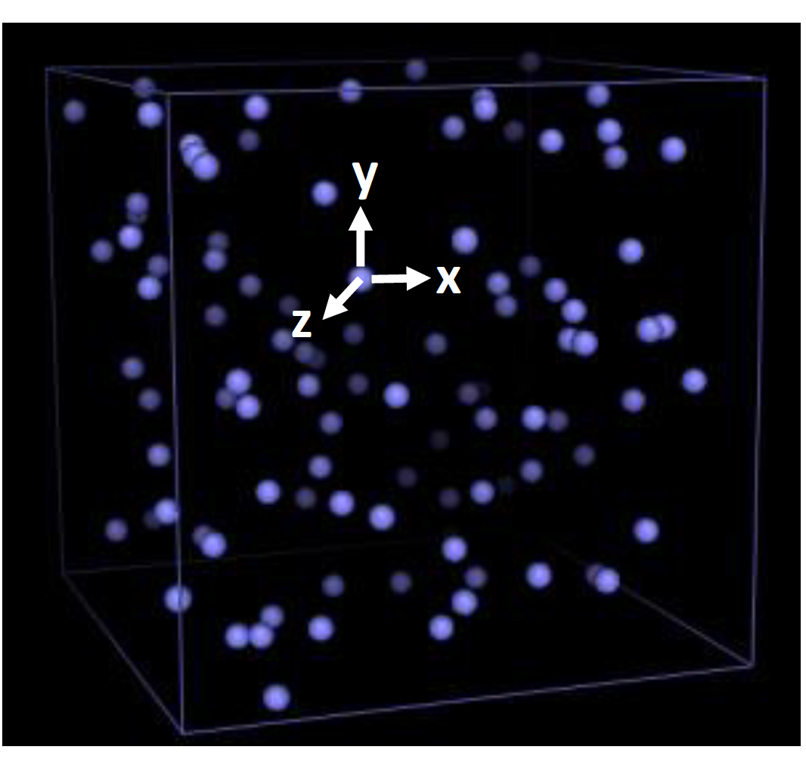
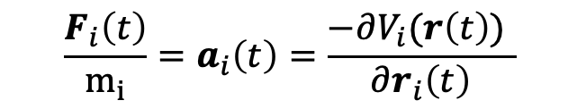
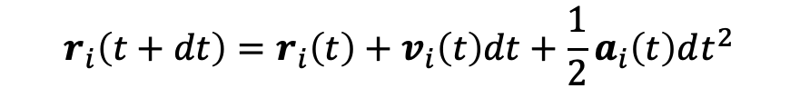
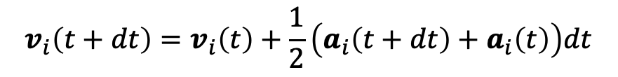
Brief overview of molecular dynamics simulations
Newton’s equations are numerically integrated for a system of N particles
$$\frac{F_{i}\left(t\right)}{m_{i}}=a_{i}\left(t\right)=\frac{−∂V_{i}(r\left(t\right)) }{∂r_{i}\left(t\right)}$$
$$v_{i}\left(t+dt\right)=v_{i}\left(t\right)+\frac{1}{2}\left(a_{i}\left(t+dt\right)+a_{i}\left(t\right)\right)dt$$
$$r_{i}\left(t+dt\right)=r_{i}\left(t\right)+v_{i}\left(t\right)dt+\frac{1}{2}a_{i}\left(t\right)dt^{2}$$

Slide 3
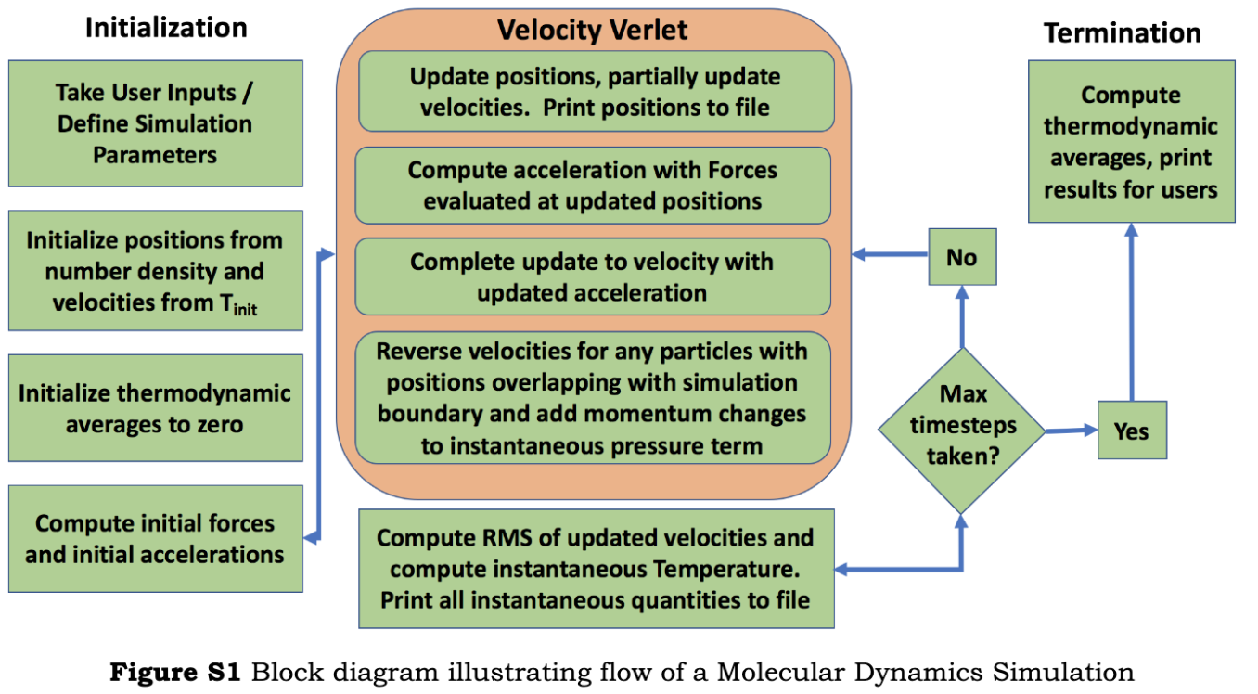
molecular dynamics simulation in a flow chart

Slide 4
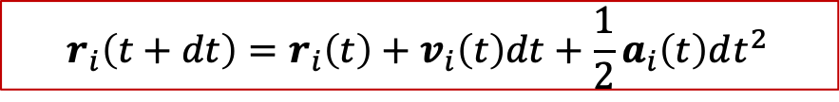
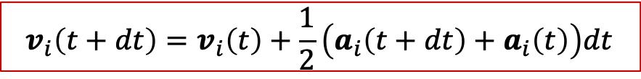
This is how we know things are classical!
Instantaneous position and velocity/momentum of all particles are the quantities that are directly simulated
$$\frac{F_{i}\left(t\right)}{m_{i}}=a_{i}\left(t\right)=\frac{−∂V_{i}(r\left(t\right)) }{∂r_{i}\left(t\right)}$$
$$v_{i}\left(t+dt\right)=v_{i}\left(t\right)+\frac{1}{2}\left(a_{i}\left(t+dt\right)+a_{i}\left(t\right)\right)dt$$
$$r_{i}\left(t+dt\right)=r_{i}\left(t\right)+v_{i}\left(t\right)dt+\frac{1}{2}a_{i}\left(t\right)dt^{2}$$

Slide 5
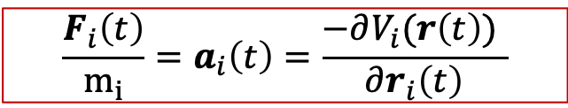
The potential governs the forces, and by extension, the dynamics
$$\frac{F_{i}\left(t\right)}{m_{i}}=a_{i}\left(t\right)=\frac{−∂V_{i}(r\left(t\right)) }{∂r_{i}\left(t\right)}$$
Potential/Force Field can be derived in a number of ways:
Model functions (e.g. Lennard-Jones, Morse) with parameters extracted from experimental observables, ab initio calculations, or both
Forces computed by ab initio calculations at each configuration as simulation is run

Slide 6
Overview of what we will do!
Compute potential at a range of separations for HF using ab initio methods with psi4numpy
Fit potential to a spline using scipy – permits us to compute potential at arbitrary separations
Differentiate spline using scipy – permits us to compute the force at arbitrary separations
Implement and validate Velocity Verlet integrator
Simulate HF’s vibrational motion with a model and ab initio potential

